Slide 1
TASK 3: Finding Vulnerabilities on testasp.vulnweb.com

Slide 2
Proof Of Concept (for XSS Payload):
Open BurpSuite on Kali Linux Machine
On the Browser, enter the url – testasp.vulnweb.com
Go to the search page of the site and then turn on BurpSuite setting on FoxyProxy
In Search field, enter our XSS Payload - <script>alert(1)</script> and go back to BurpSuite
For the request, forward the request to introducer.
Clear all payloads and then add the particular text you want as payload.
On the payload tab, import selected text file containing payloads and start the attack

Slide 3
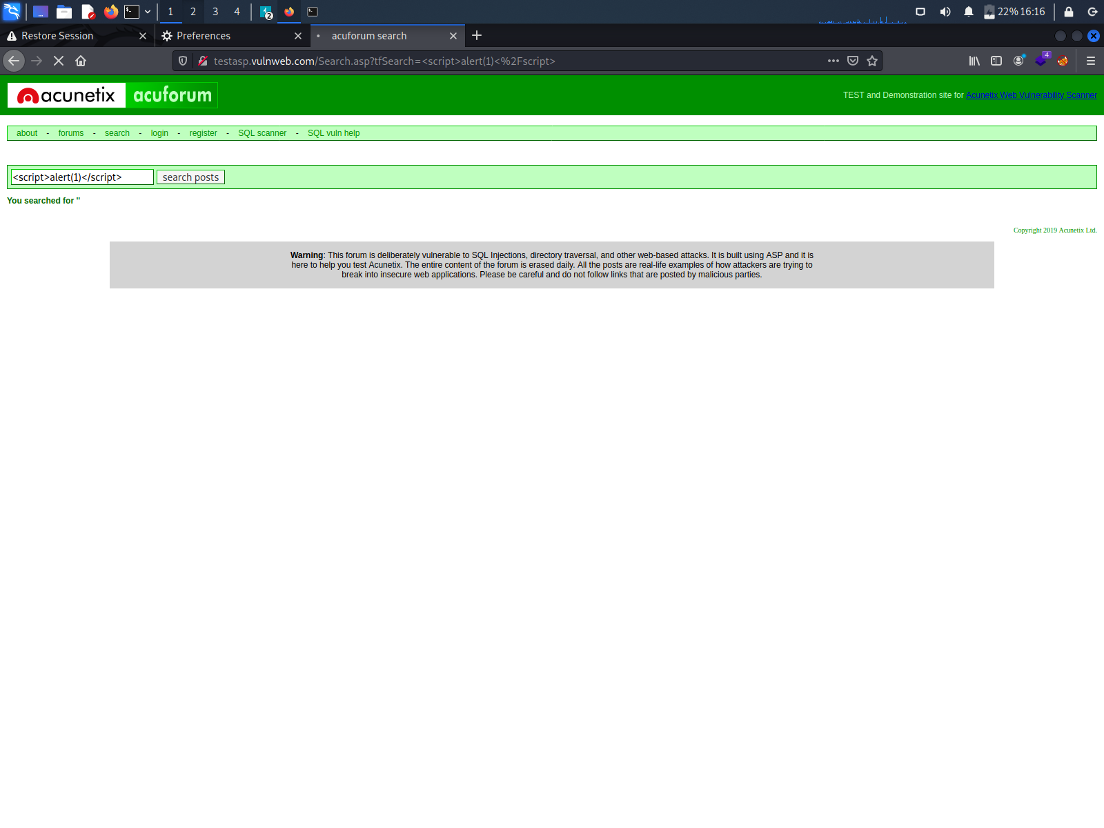
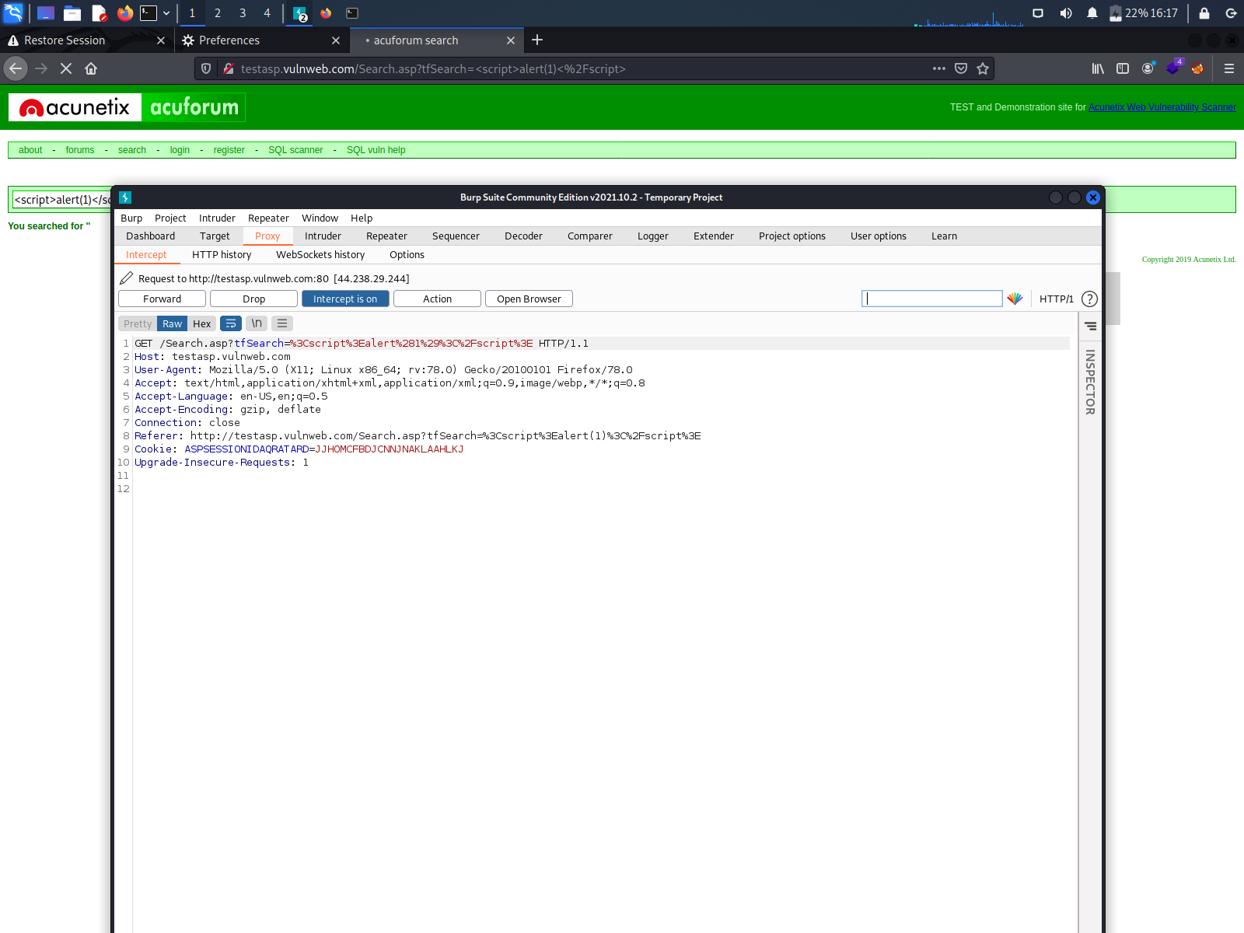
Screenshots:

Slide 4
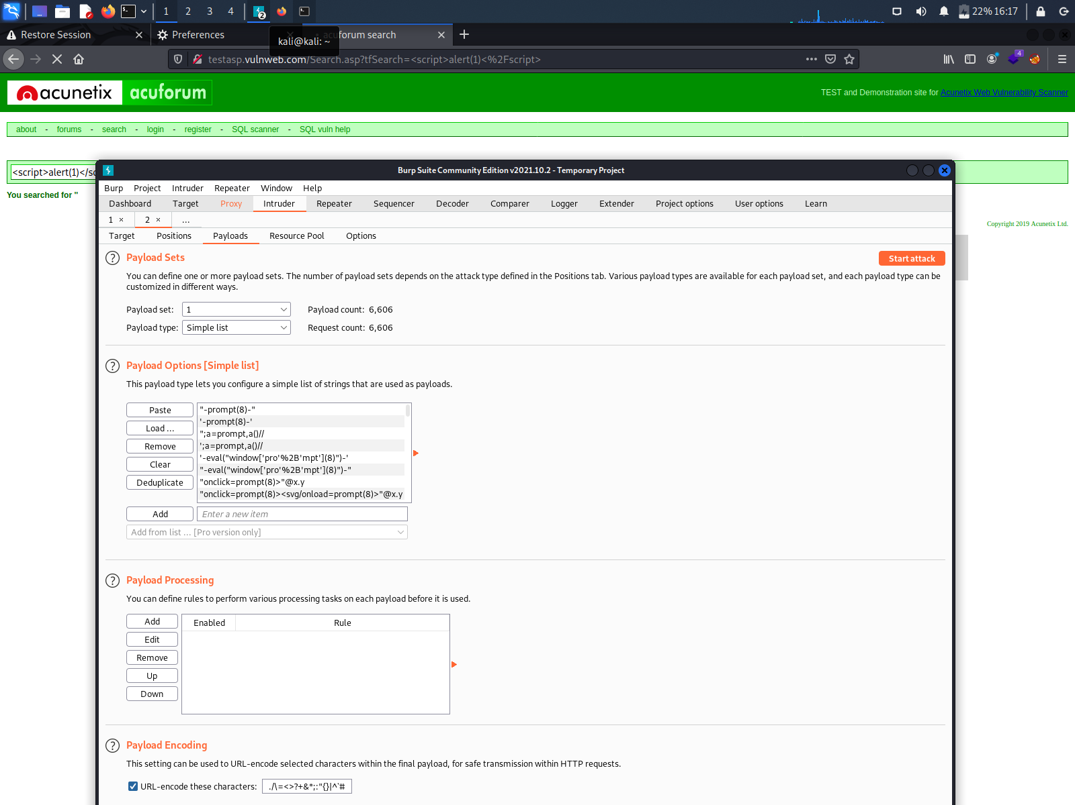

Slide 5
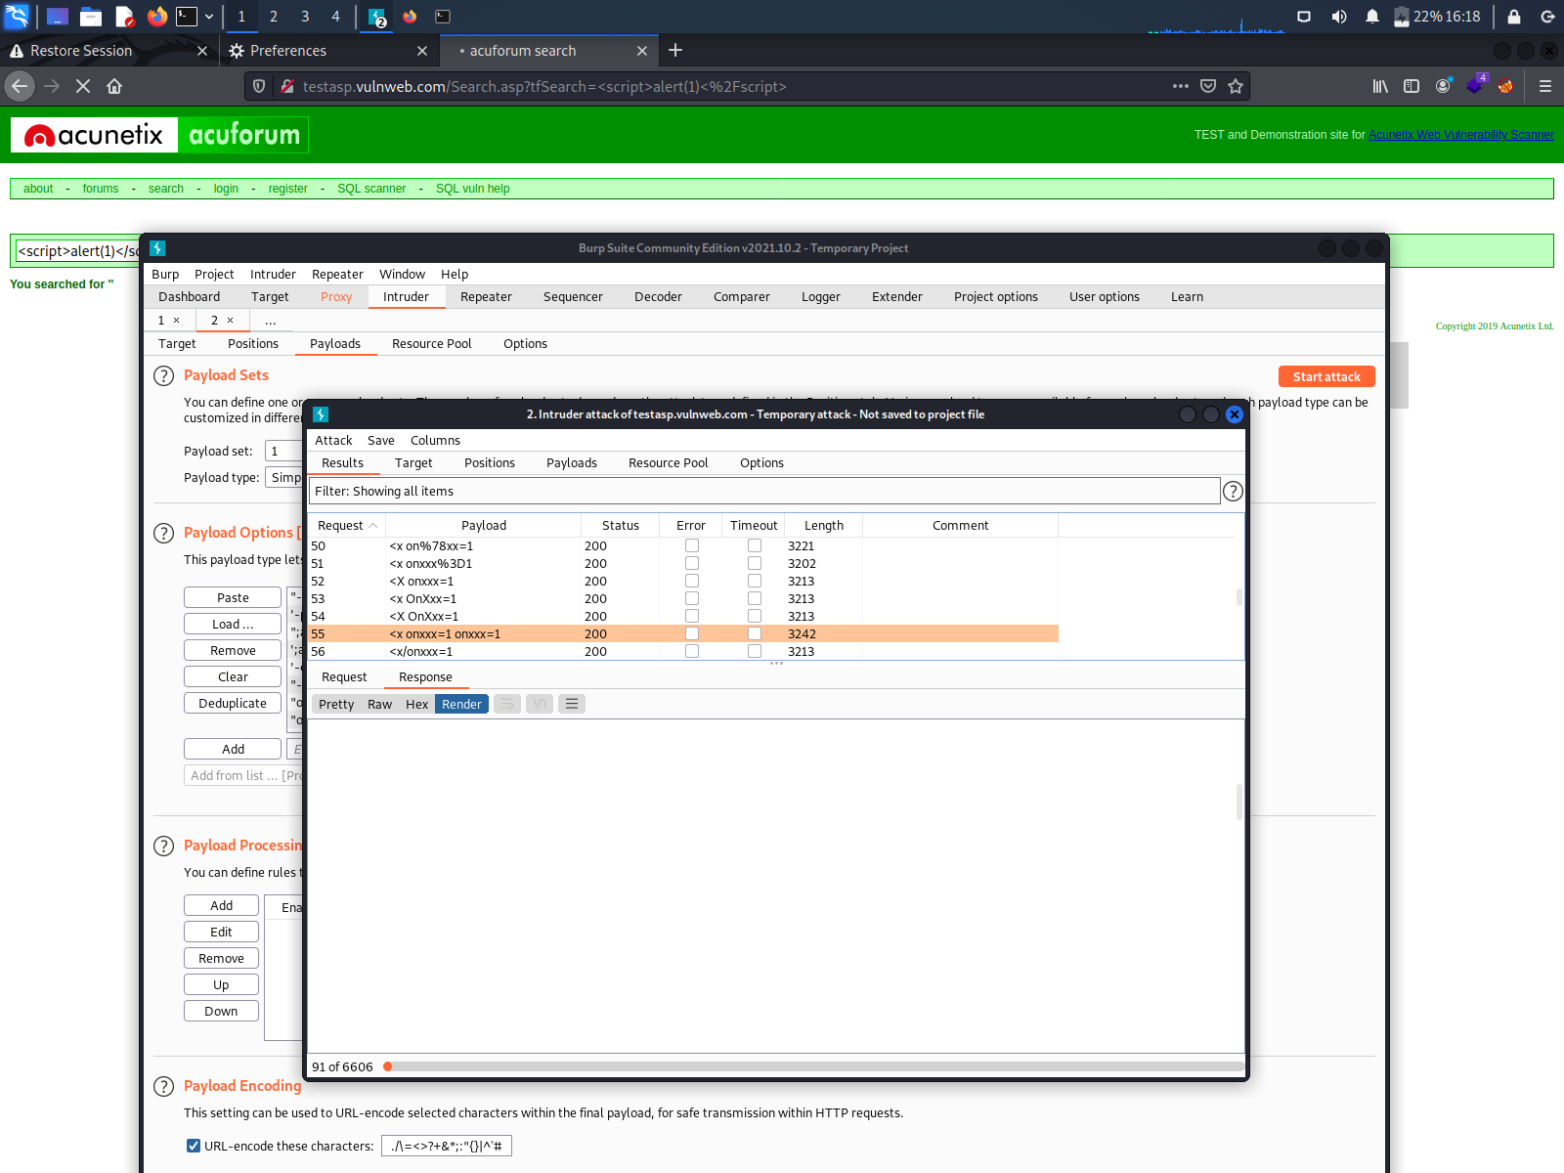

Slide 6
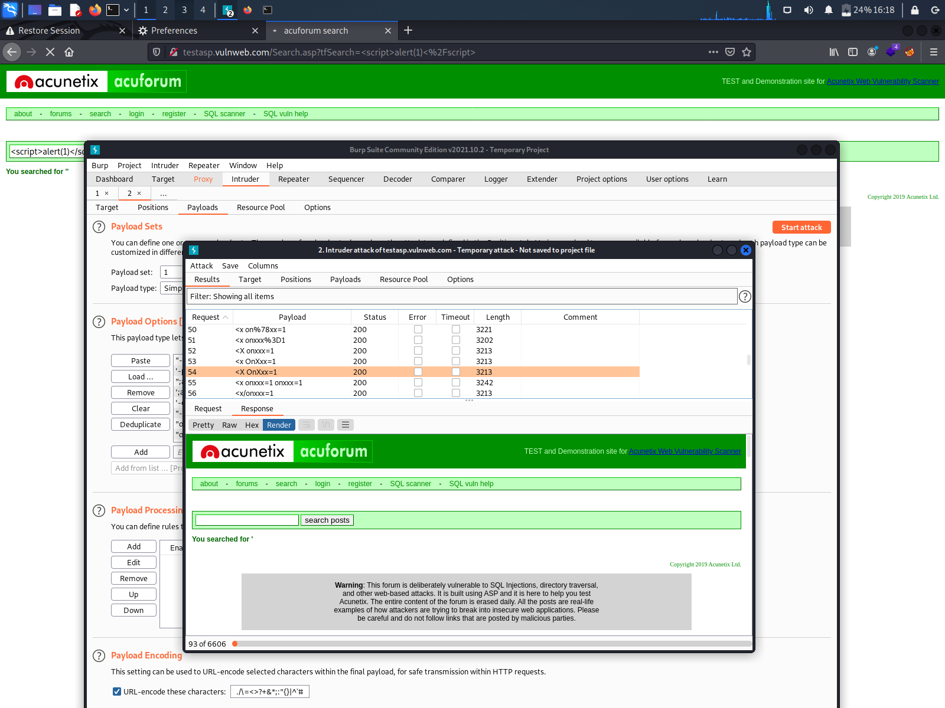

Slide 7

Video of POC:

Slide 8
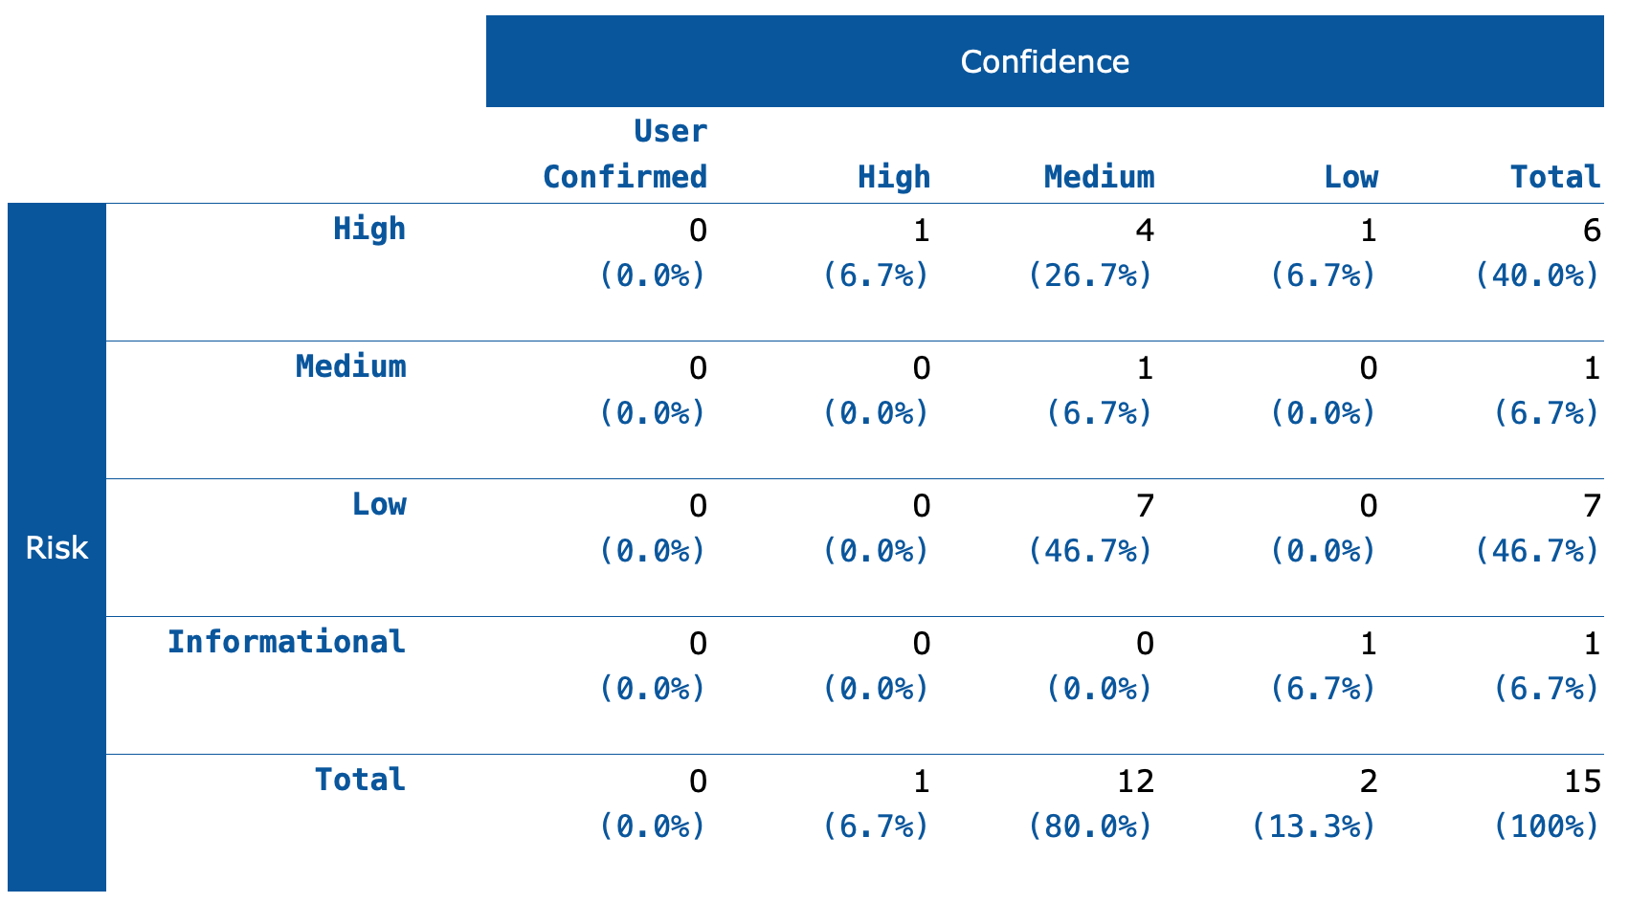
Other vulnerabilities found using OWASP ZAP Tool

Slide 9
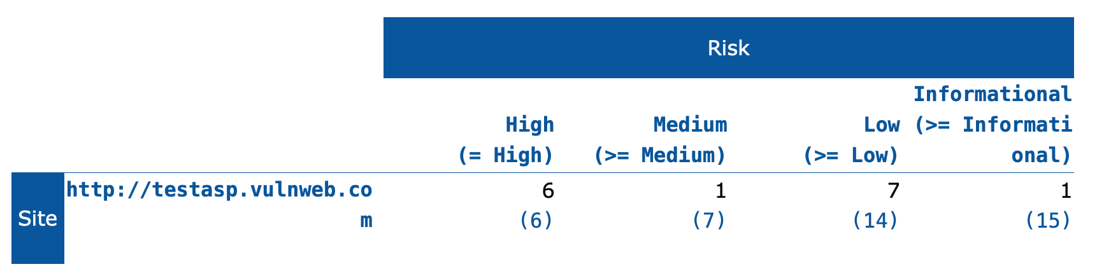
Risk Ratio:

Slide 10
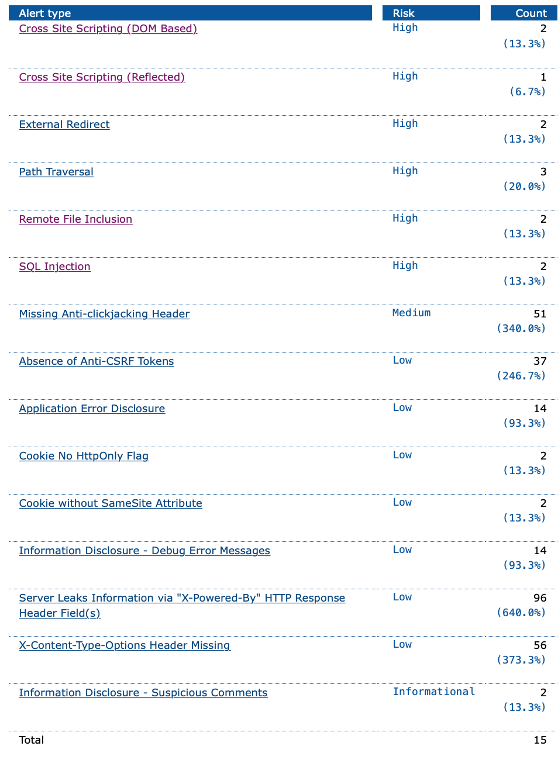
Alert Types:

Slide 11
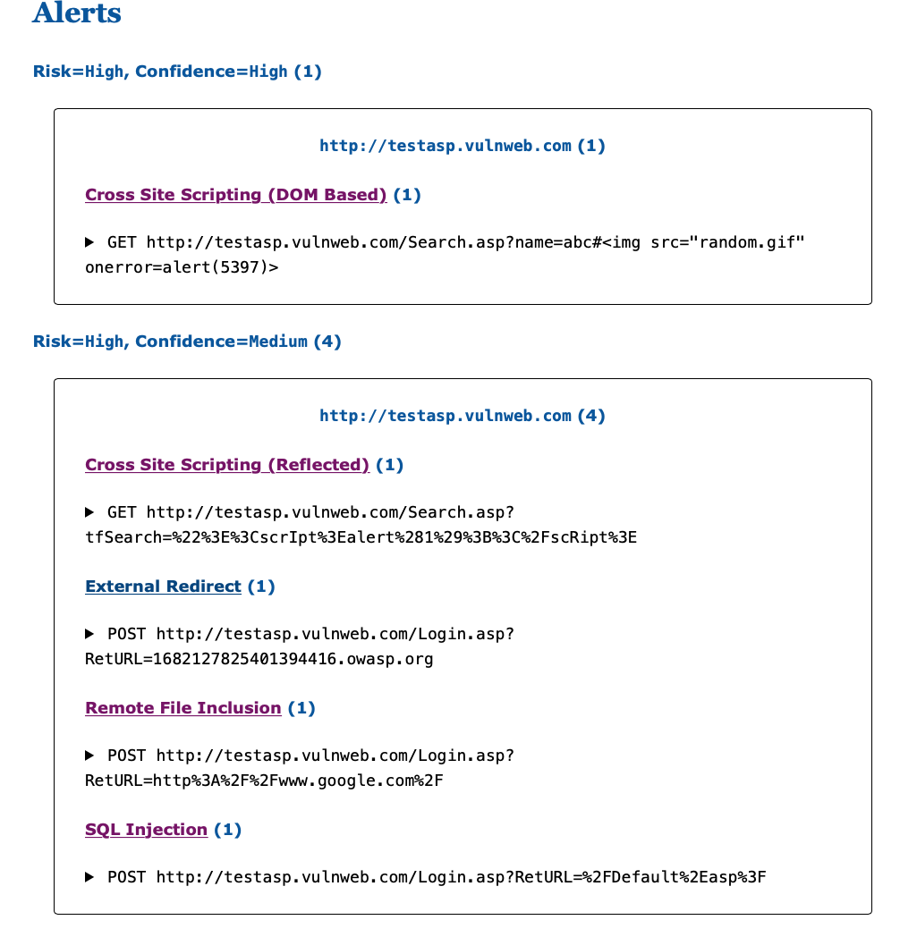
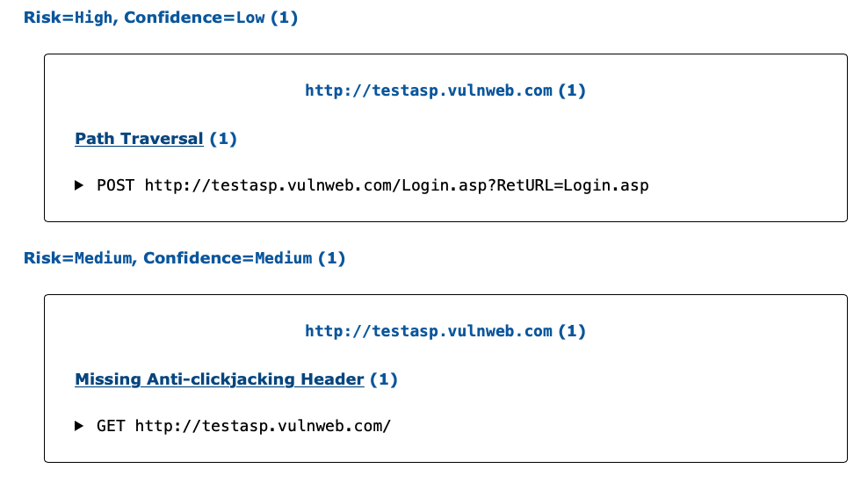

Slide 12
